Slide 1




Data Communication Concepts
Troubleshooting IPv4 Network Connectivity
Lab Four

Slide 2
Outline
Outline
Overview
Ipconfig Command
Ping Command
Trace Route Command

Slide 3
Outline
Overview
In this lab, we will learn about troubleshooting and testing command .

Slide 4
Outline
Ipconfig Command
You can use the ipconfig utility to verify the TCP/IP configuration parameters on a host. This helps to determine whether the configuration is initialized or whether a duplicate IP address exists. To use this tool enter to the command window (cmd) in each host and write the following syntax:
ipconfig

Slide 5
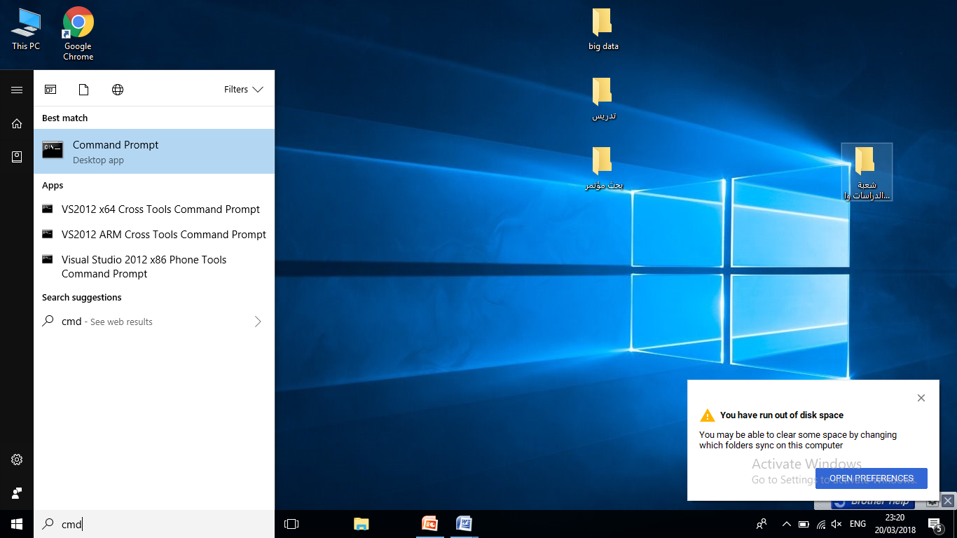
Outline
Ipconfig Command
2
1

Slide 6
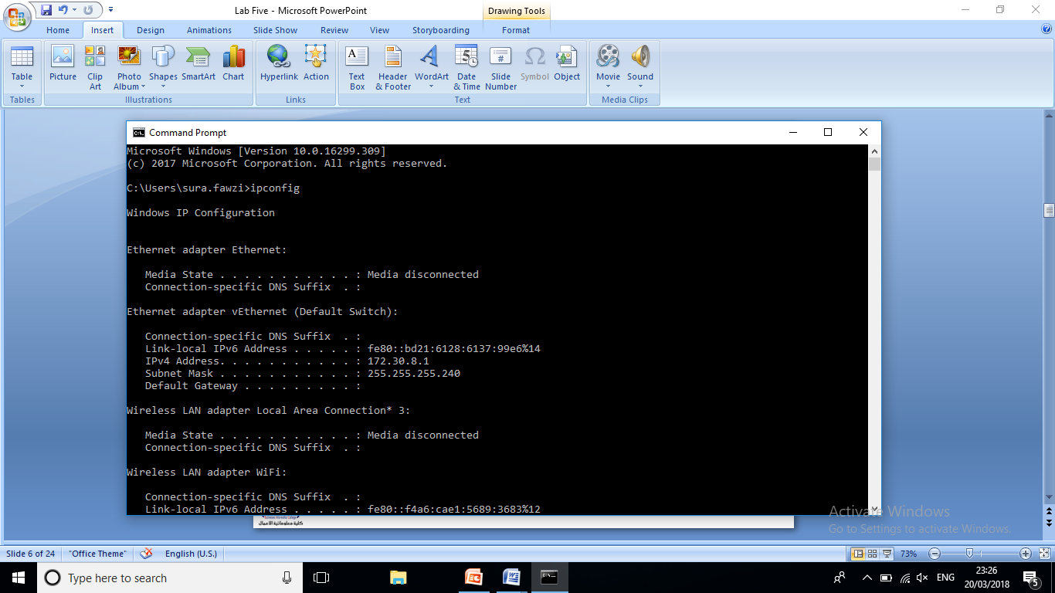
Outline
Ipconfig Command
3

Slide 7
Outline
Ping Command
PING, the Packet Inter Net Groper, allows a user to test basic connectivity.
The ping utility is a diagnostic tool you can use to test TCP/IP configurations and diagnose connection failures. Use the ping utility to determine whether a particular TCP/IP host is available and functional. To test connectivity, use the ping command with the following syntax:
ping <IP_address>

Slide 8
Outline
Ping Command (Continue…)
A successful ping:
PC>ping 10.0.0.1
Pinging 10.0.0.1 with 32 bytes of data:
Reply from 10.0.0.1: bytes=32 time=49ms TTL=128
Reply from 10.0.0.1: bytes=32 time=7ms TTL=128
Reply from 10.0.0.1: bytes=32 time=7ms TTL=128
Reply from 10.0.0.1: bytes=32 time=8ms TTL=128
Ping statistics for 10.0.0.1:
Packets: Sent = 4, Received = 4, Lost = 0 (0% loss),
Approximate round trip times in milli-seconds:
Minimum = 7ms, Maximum = 49ms, Average = 17ms

Slide 9
Outline
Ping Command (Continue…)
A failed ping:
PC>ping 10.0.0.3
Pinging 10.0.0.3 with 32 bytes of data:
Request timed out.
Request timed out.
Request timed out.
Request timed out.
Ping statistics for 10.0.0.3:
Packets: Sent = 4, Received = 0, Lost = 4 (100% loss)

Slide 10
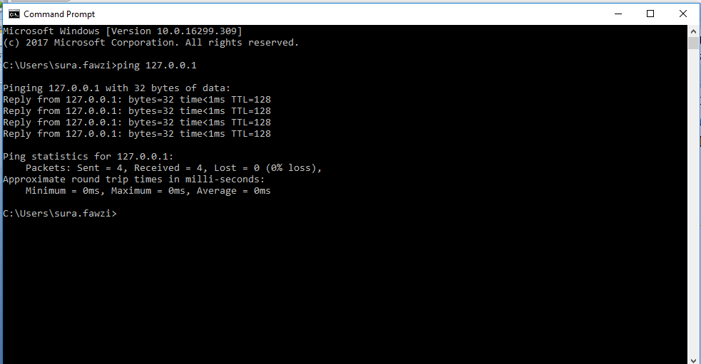
Ping Command (Continue…)
Outline

Slide 11
Outline
Ping Command (Continue…)
ping [-t] [-a] [-n count] [-l length] <IP_address>
Parameters
-t : Pings the specified computer until interrupted.
-a : Resolves addresses to computer names.
-n count : Sends the number of ECHO packets specified by count. The default is 4.
-l length : Sends ECHO packets containing the amount of data specified by length. The default is 32 bytes; the maximum is 65,527.

Slide 12
Ping Command
Outline
The following example illustrates how to send two pings, each 1450 bytes in size, to address 10.99.99.2:
C:\>ping -n 2 -l 1450 10.99.99.2
Pinging 10.99.99.2 with 1450 bytes of data:
Reply from 10.99.99.2: bytes=1450 time<10ms TTL=32
Reply from 10.99.99.2: bytes=1450 time<10ms TTL=32
Ping statistics for 10.99.99.2:
Packets: Sent = 2, Received = 2, Lost = 0 (0% loss),
Approximate round trip times in milliseconds:
Minimum = 0ms, Maximum = 0ms, Average = 0ms

Slide 13
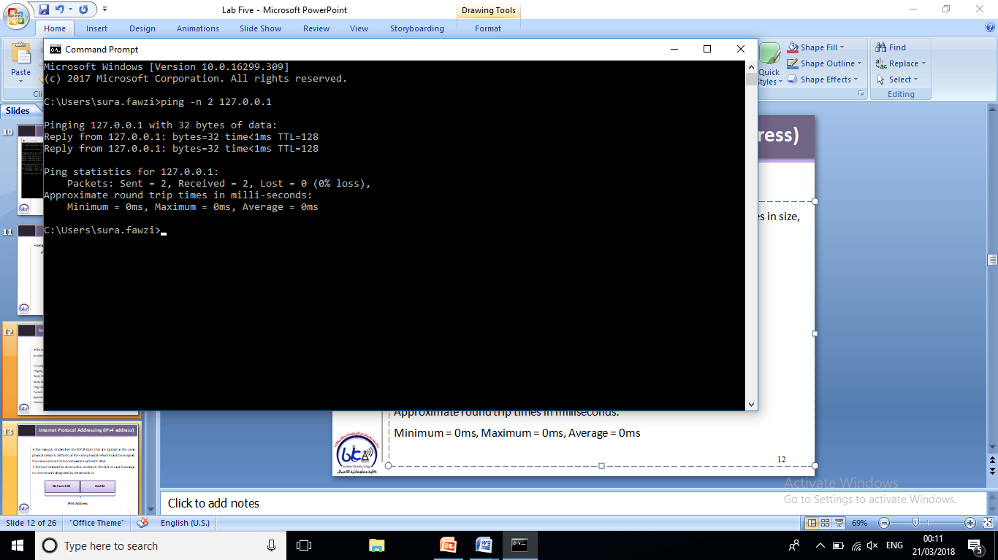
Ping Command
Outline
The following real example illustrates how to send a two pings command to IP 127.0.0.1

Slide 14
Outline
Trace Route Command
The goal behind the trace route command is to help you troubleshoot and determine the path a packet is taking to get to a destination device. The syntax of trace route in host is:
tracert ip-address

Slide 15
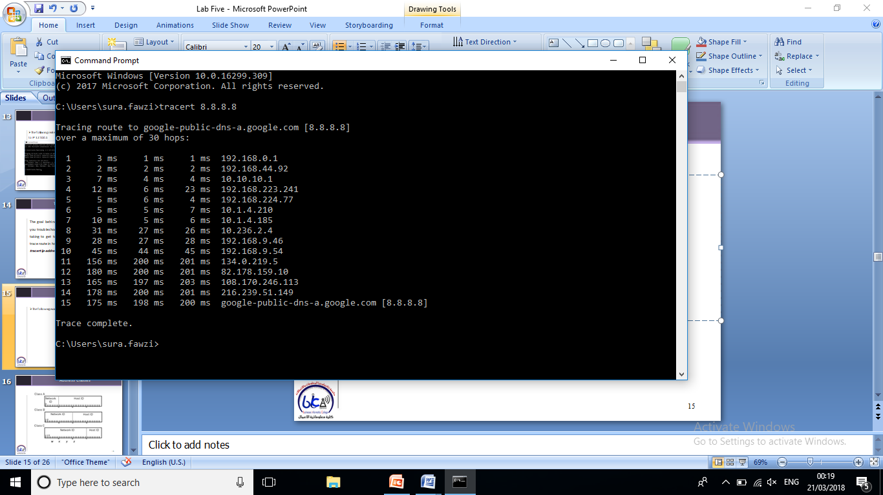
Outline
Trace Route Command
The following example illustrates the trace route command
The following example illustrate tracert command

Slide 16
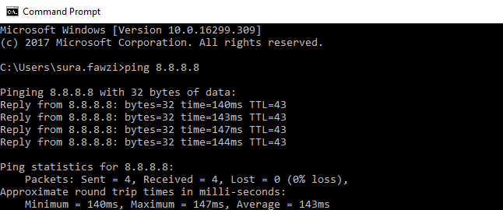
Outline
The Difference between Ping and Tracert
Ping
Tracert

Slide 17


THANK YOU

